Slide 1
Overview of Communities in networks
Ralucca Gera,
Naval Postgraduate School
Monterey, California
rgera@nps.edu

Slide 2
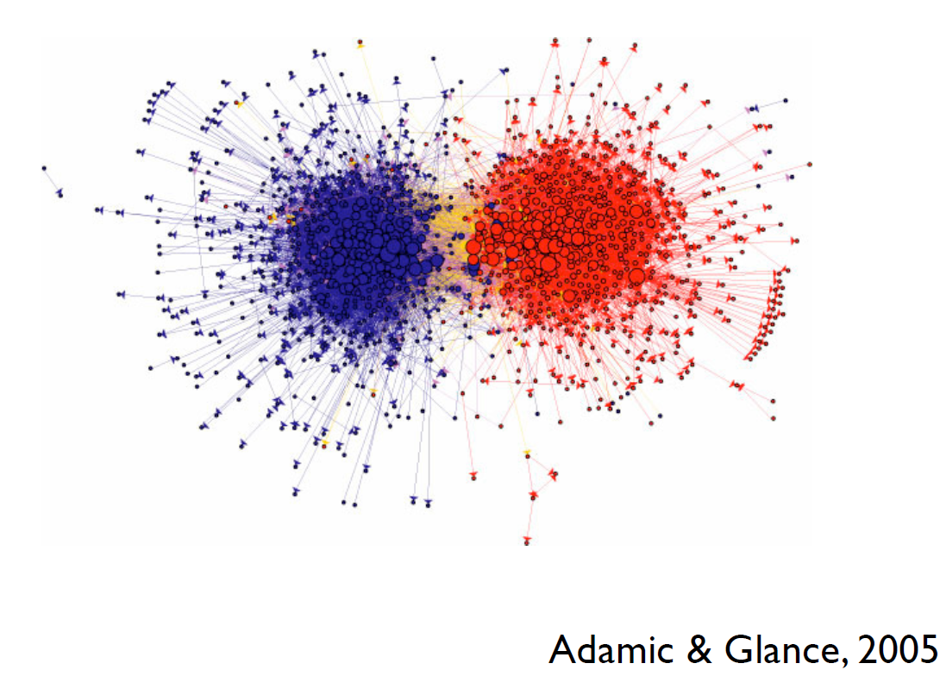
What is a community?
A community ~ a group of people with common characteristic or shared interests
What do they correspond to?
Why do they form?

Slide 3
What is a community?
A community in a network is a subset of nodes that share common or similar characteristics, based on which they are grouped.
In a social network it might indicate a circle of friends,
In the World Wide Web it might indicate a group of pages on closely related topics,
In a network of emails it may indicate groups of emails that have similar patterns or domain or belong to individuals that correspond on a regular basis.
Community detection: partitioning the nodes into communities

Slide 4
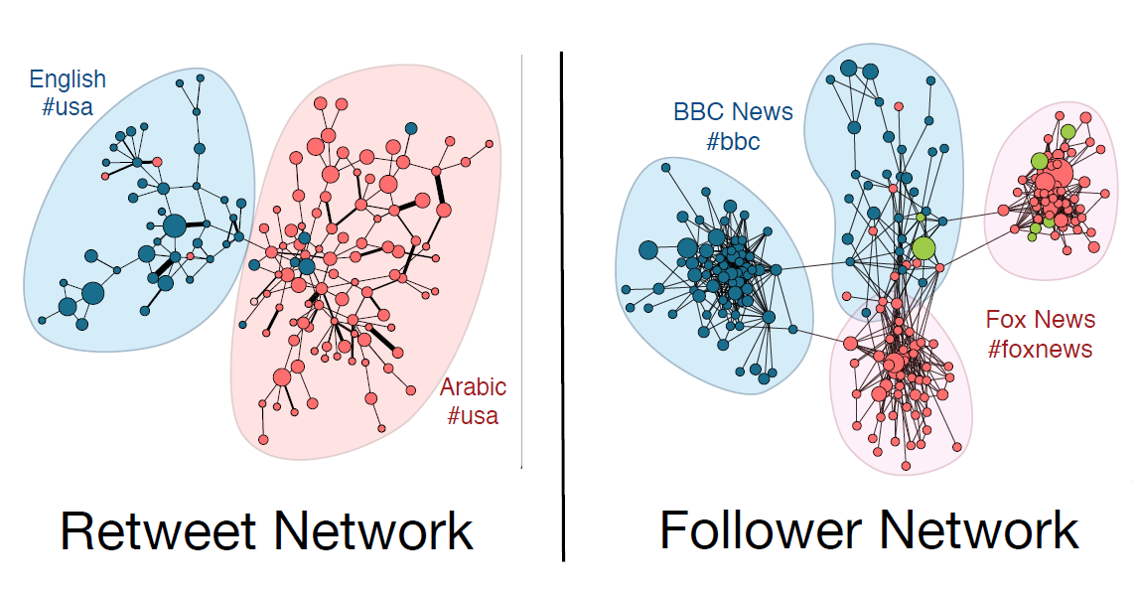
What might influence a community?
Homophily: similar nodes cluster together, for example based on Language or maybe based on degree (for degree homophily)
__________________________________________________________________________
Virality Prediction and Community Structure in Social Networks Yong-Yeol “YY” Ahn

Slide 5
Community Detection in Network Science
Communities are features that naturally appear in real networks, and they are generally captured through the structural properties of the network: nodes tend to cluster based on common intrerests.
The amount of research since 2002 in this area is massive,
Based on its usefulness, community detection became one of the most prominent directions of research in network science.
It is one of the common analysis tools in understanding networks

Slide 6
Overview
Fundamental concepts for clustering
Based on density and topological structures

Slide 7
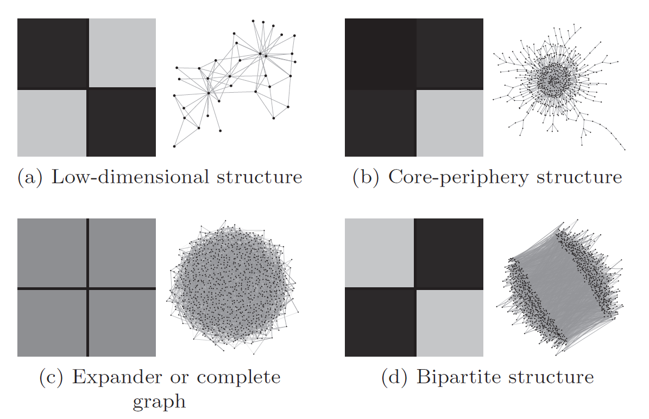
Adjacency matrices of different types of networks
General way of viewing an adjacency matrix for large networks:
Dark = 1 (or weights)
Gray = 0
Rarely found in real networks
Commonly found in real networks
Nodes
of two
types
Commonly found in real networks
Figure: (a) good spectral clustering (b) core-periphery structure (c) unstructured, (d) either way
Ref: “Think locally, act locally: Detection of small, medium-sized, and large communities in large networks” by Jeub et al, 2015

Slide 8
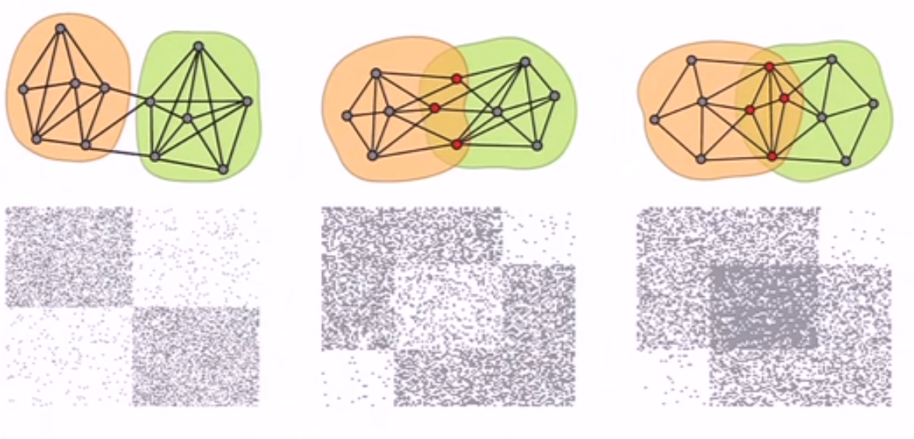
Adjacency matrices (some overlapping communities)
From Jure Leskovec: https://www.youtube.com/watch?v=htWQWN1xAZQ

Slide 9
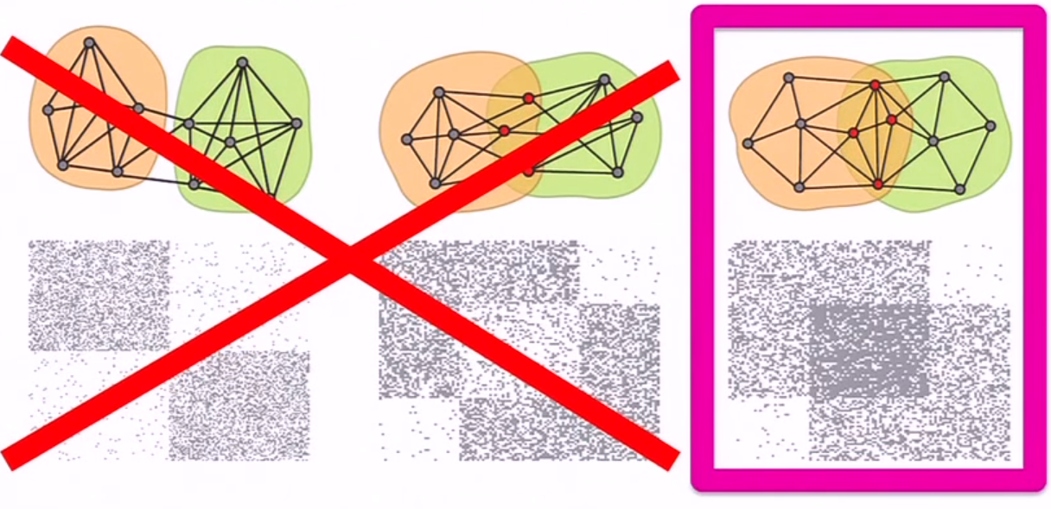
Reality: Maybe dense overlapping communities (2 or 3 comms)
From Jure Leskovec: https://www.youtube.com/watch?v=htWQWN1xAZQ

Slide 10
General methodology (1)
General methodology from Leskovec’s paper (Stanford):
Data is modeled by an “interaction graph”
(2) Hypothesis: networks have communities that interact strongly amongst themselves than with the outside world (more “internal edges” to each community, than “cut edges” connecting the comm. to the rest of the world).
(3) A objective function or metric is chosen to formalize this idea of groups with more intra-group than intergroup connectivity.

Slide 11
General methodology (2)
(4) An algorithm is then selected to find communities that optimize the function.
(5) The communities are then evaluated in some way.
For example, one may map the sets of nodes back to the real world to see whether they appear to make intuitive sense as a plausible social community.
Alternatively, one may have labeled data (or ground truth) to compared with it.
How can one identify communities?

Slide 12
Clustering methodologies
Nonoverlapping
Overlapping
Louvain Method
Girvan-Newman algorithm
Minimum-cut method
Modularity maximization
Clique Percolation

Slide 13
Non-overlapping communities (node partitioning into communities)

Slide 14
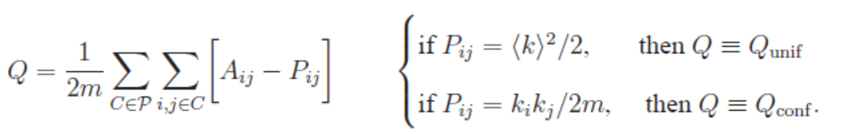
Modularity
Define modularity as:
Q = # edges within communities - expected # edge of a null model network (same size),
Where “expected” come from a “null model” to compare our network against: networks with the same n and m, where edges are placed at random (like ER, Config.)
Modularity is a scale value between -1 and 1 that measures the density of edges inside communities to edges outside communities
Larger values of Q indicating stronger community structure.
Goal: assign nodes to community to maximize Q

Slide 15
Louvain method (partition the nodes)
Goal: optimize modularity → theoretically results in the best possible grouping of the nodes of a given network (it depends on the function of the network, the reason behind clustering)
The Louvain Method of community detection:
find small communities by optimizing modularity locally on all nodes,
then each small community is grouped into one node
then the first step is repeated
Visualization: https://www.youtube.com/watch?v=dGa-TXpoPz8

Slide 16
Louvain method (2)
Simple, efficient and easy-to-implement (implemented in NetworkX, Matlab, C++, and Gephi)
For community detection in large networks
For sizes up to 100 million nodes and billions of links.
The analysis of a typical network of 2 million nodes takes 2 minutes on a standard PC.
The method unveils hierarchies of communities and allows to zoom within communities to discover sub-communities, sub-sub-communities, etc.
It is today one of the most widely used method for detecting communities in large networks.

Slide 17
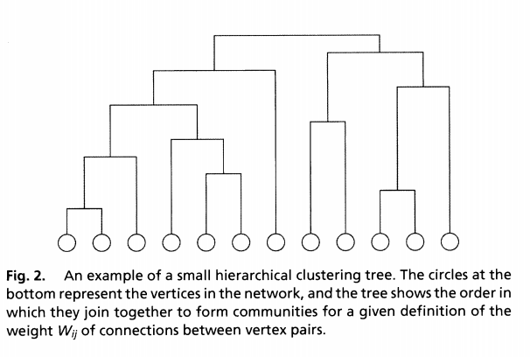
Girvan Newman’s method (partition the nodes)
The Girvan–Newman algorithm detects communities by progressively removing edges (with high betweeness centrality) from the original network.
These edges are believed connect communities
Algorithm stops when there are no edges between the identified communities.
Implemented in R and python

Slide 18
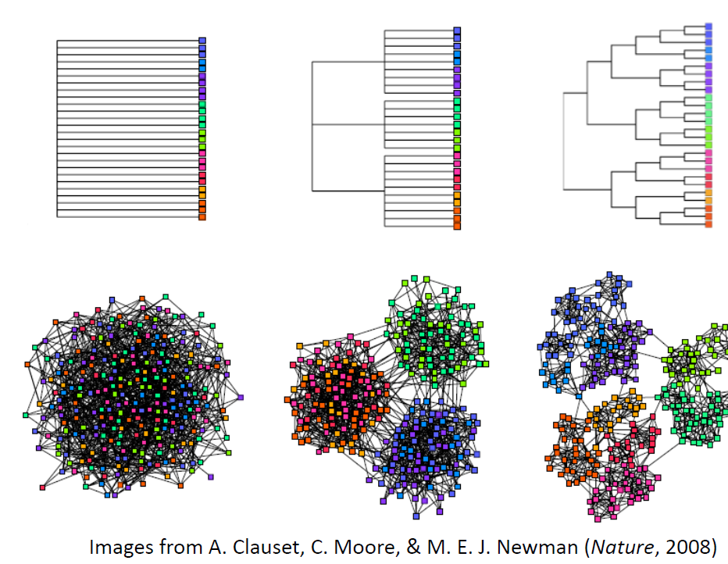
Girvan Newman’s method (2)

Slide 19
Overlapping communities

Slide 20
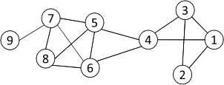
Cliques
Nodes 5, 6, 7 and 8 form a clique
20
Clique: a maximum complete subgraph in which all nodes are adjacent to each other
NP-hard to find the maximum clique in a network
Straightforward implementation to find cliques is very expensive in time complexity

Slide 21
Clique Percolation Method (CPM)
Normally use cliques as a core or a seed to find larger communities
Clique Percolation Method to find overlapping communities (diagram on next page)
Input
A parameter k, and a network
Procedure
Find out all cliques of size k in a given network
Construct a clique graph: two cliques are adjacent if they share k-1 nodes
The nodes depicted in the labels of each connected components in the clique graph form a community
21

Slide 22
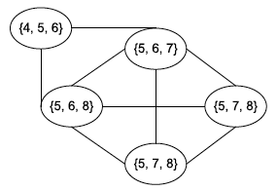
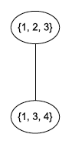
CPM Example
Parameter = 3
Cliques of size 3:
{1, 2, 3}, {1, 3, 4}, {4, 5, 6}, {5, 6, 7}, {5, 6, 8}, {5, 7, 8},
{6, 7, 8}
Clique graph
Communities:
{1, 2, 3, 4}
{4, 5, 6, 7, 8}
22

Slide 23
Community Detection evaluation

Slide 24
Community detection evaluation
Map the sets of nodes back to the real world to see whether they appear to make intuitive sense as a plausible social community.
Acquire some form of ground truth, in which case the set of nodes output by the algorithm may be compared with it (compare it using Normalized Mutual Index).
Modularity and Conductance are the popular theoretical metric to evaluate the quality of the communities:
Network Community Profile: identifies the best community among all the communities of the same size
Create an application and use the derived community structure

Slide 25
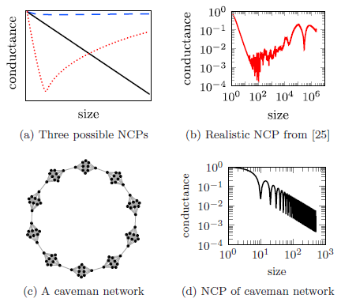
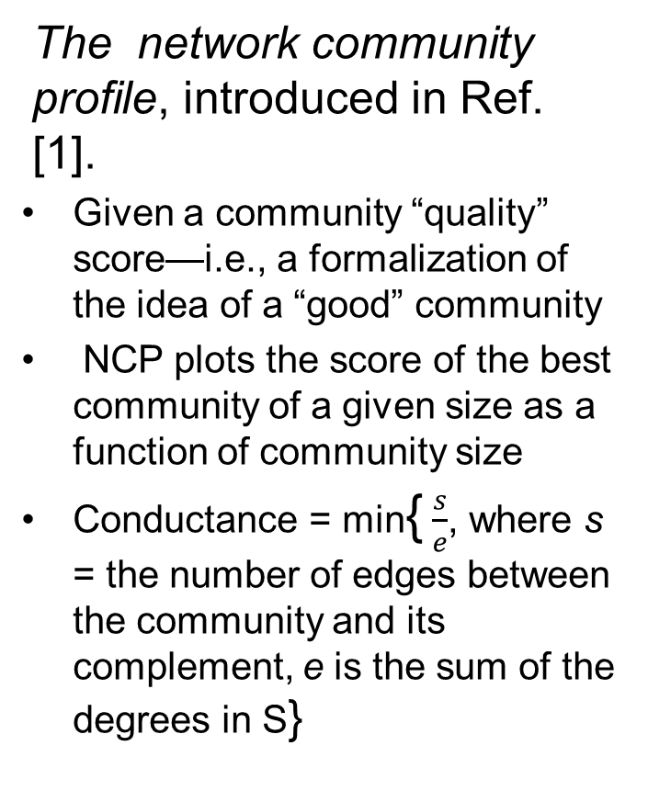
Network Community Profile
The network community profile, introduced in Ref. [1].
Given a community “quality” score—i.e., a formalization of the idea of a “good” community
NCP plots the score of the best community of a given size as a function of community size
Conductance = min{ $\frac{s}{e}$, where s = the number of edges between the community and its complement, e is the sum of the degrees in S}
“Think locally, act locally: Detection of small, medium-sized, and large communities in large networks” by Jeub et al, 2015

Slide 26
Network Community Profile

Slide 27
Generative models preserving community structure

Slide 28
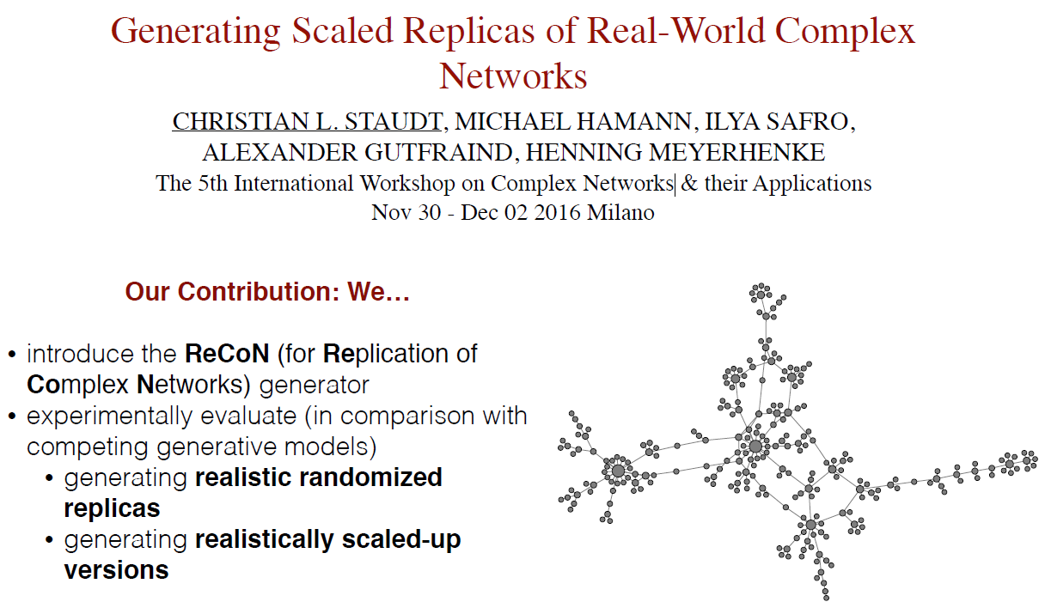
ReCoN:
Christian L. Staudt, Aleksejs Sazonovs, Henning Meyerhenke: NetworKit: A Tool Suite for Large-scale Complex Network Analysis. Network Science, to appear 2016.
https://networkit.iti.kit.edu/

Slide 29
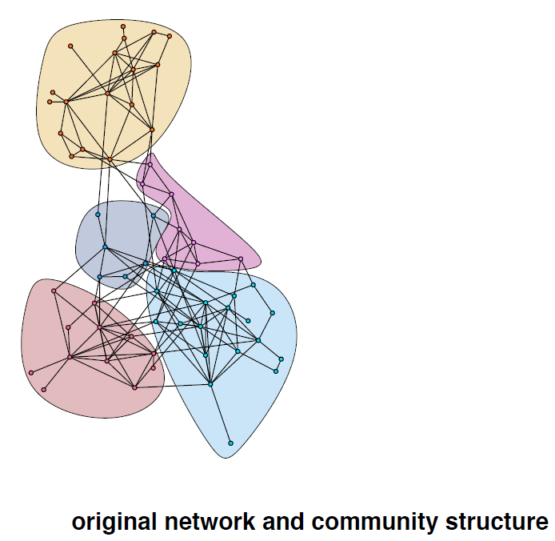
ReCoN Algorithm Example
https://networkit.iti.kit.edu/

Slide 30
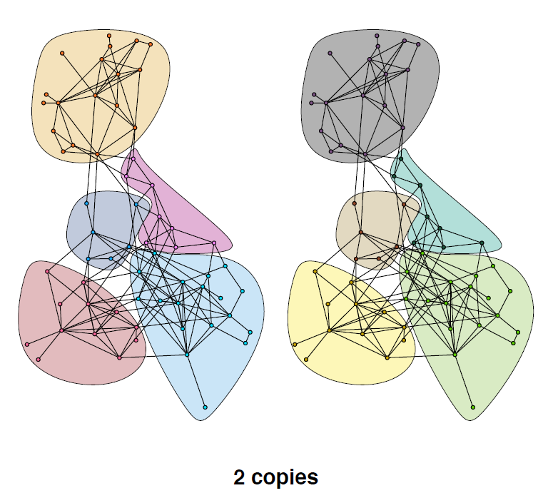
ReCoN Algorithm Example
https://networkit.iti.kit.edu/

Slide 31
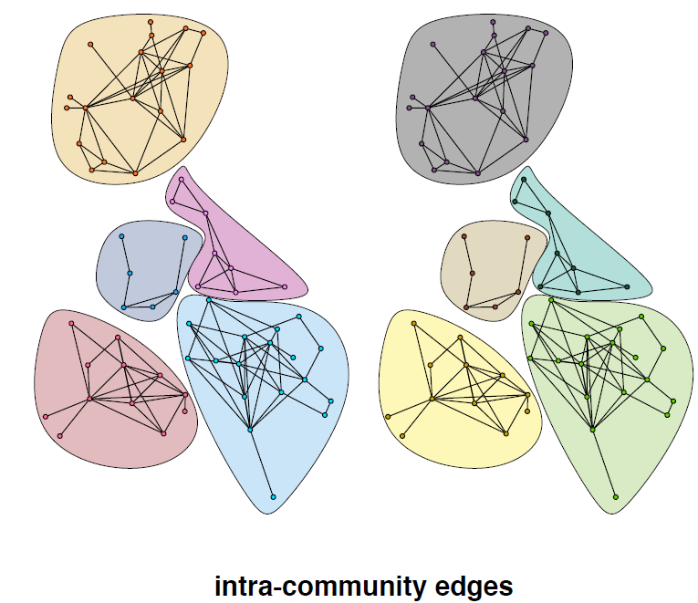
ReCoN Algorithm Example
https://networkit.iti.kit.edu/

Slide 32
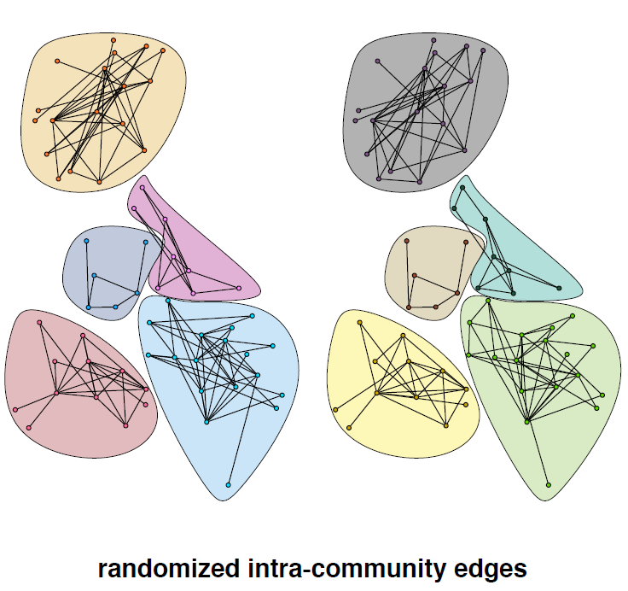
ReCoN Algorithm Example
https://networkit.iti.kit.edu/

Slide 33
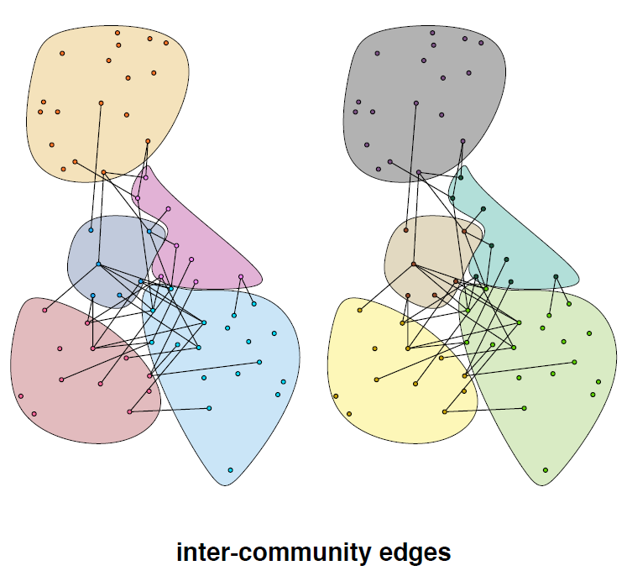
ReCoN Algorithm Example
https://networkit.iti.kit.edu/

Slide 34
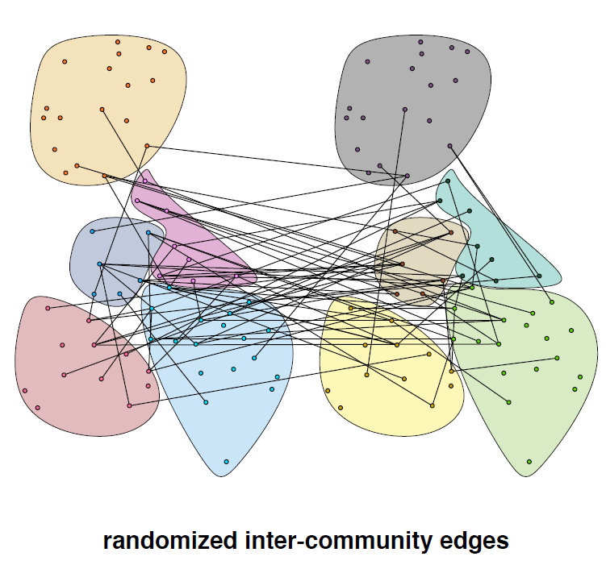
ReCoN Algorithm Example
https://networkit.iti.kit.edu/

Slide 35
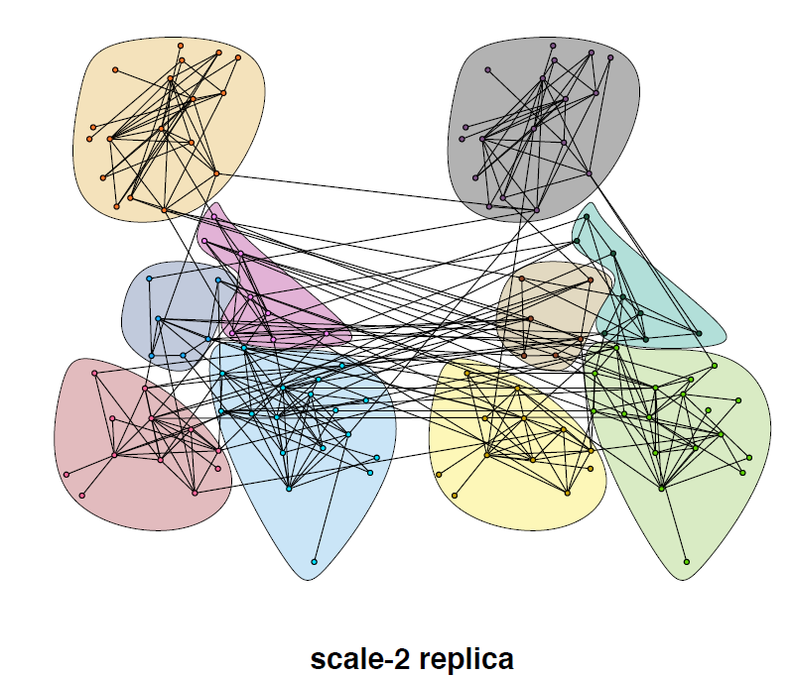
ReCoN Algorithm Example
https://networkit.iti.kit.edu/

Slide 36
Main references
Some text and pictures in this presentation were taken from:
[1] “Statistical Properties of Community Structure in Large Social and Information Networks” by Jure Leskovec∗ Kevin J. Lang† Anirban Dasgupta† Michael W. Mahoney
[2] Conversations and PPT from Mason Porter, Oxford.
[3] https://networkit.iti.kit.edu/

Slide 37
Main references
[1] Kivelä, M., Arenas, A., Barthelemy, M., Gleeson, J.P., Moreno, Y. and Porter, M.A., 2014. Multilayer networks. Journal of complex networks, 2(3), pp.203-271.
[2] Lucas G. S. Jeub, Prakash Balachandran, Mason A. Porter, Peter J. Mucha, and Michael W. Mahoney, “Think locally, act locally: Detection of small, medium-sized, and large communities in large networks” PHYSICAL REVIEW E 91, 012821 (2015)
[3] J. Leskovec, K. J. Lang, A. Dasgupta, and M. W. Mahoney, Internet Math. 6, 29 (2009).
[4] M. E. Newman “Finding community structure in networks using the eigenvectors of matrices” PHYSICAL REVIEW E 74, 036104 (2006)
[5] Aggarwal, Charu C., and Haixun Wang. "Graph data management and mining: A survey of algorithms and applications." Managing and Mining Graph Data. Springer US, 2010. 13-68.

Slide 38
Surveys
Malliaros, Fragkiskos D., and Michalis Vazirgiannis. "Clustering and community detection in directed networks: A survey." Physics Reports 533.4 (2013): 95-142.
Social Media: http://link.springer.com/article/10.1007/s10618-011-0224-z#page-1
Graph mining and management (clustering networks):Aggarwal, Charu C., and Haixun Wang. "Graph data management and mining: A survey of algorithms and applications." Managing and Mining Graph Data. Springer US, 2010. 13-68.
Encyclopedia of Distances

Slide 39
General reference papers
Porter, Mason A., Jukka-Pekka Onnela, and Peter J. Mucha. "Communities in networks." Notices of the AMS 56.9 (2009): 1082-1097.
Vishwanathan, S. Vichy N., et al. "Graph Kernels" The Journal of Machine Learning Research 11 (2010): 1201-1242.
Fast computing random walk kernels: Borgwardt, Karsten M., Nicol N. Schraudolph, and S. V. N. Vishwanathan. "Fast computation of graph kernels." Advances in neural information processing systems. 2006.
An alternative to kernels using graphlets: Shervashidze, Nino, et al. "Efficient graphlet kernels for large graph comparison." International conference on artificial intelligence and statistics. 2009.
Karsten M. Borgwardt and Hans-Peter Kriege Shortest path kernels, IEEE International Conference on Data Mining (ICDM’05) 2005
Robustness in Modular structure
Relative centrality and local community

